Slide 1
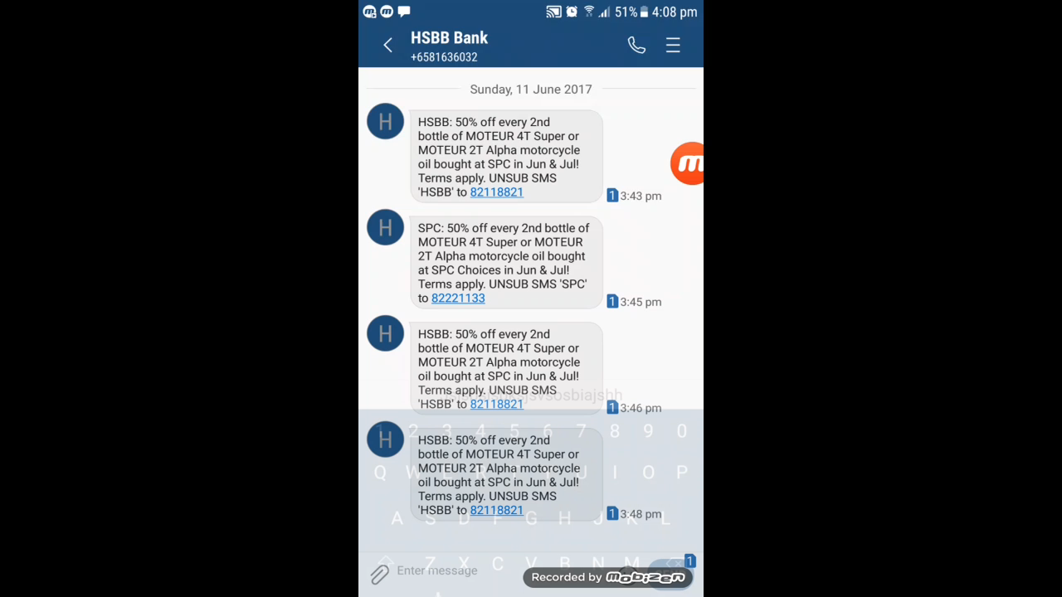

Slide 2

CITI BANKING 101
AR/VR Pitch
CHANG BAO HUI
AISYAH YUSOFF
WANG RIWU
AARON TAN YAN HONG
DERRICK ONG JIA YU

Slide 3
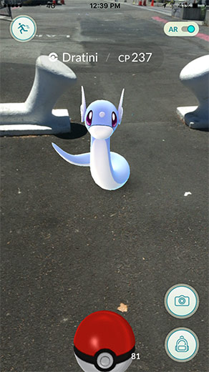
Augmented Reality
A/R is a technology that superimposes a computer-generated image on a user’s view of the real world.
AR
AR

Slide 4
Introduction to Problem Statement
Sources of information
Word of mouth / Calls
Advertisements
Internet Search
Text Messages

Slide 5
Introduction to Problem Statement
AR/VR Pitch
How do we effectively reach out to digital users who have evolving lifestyle needs?

Slide 6
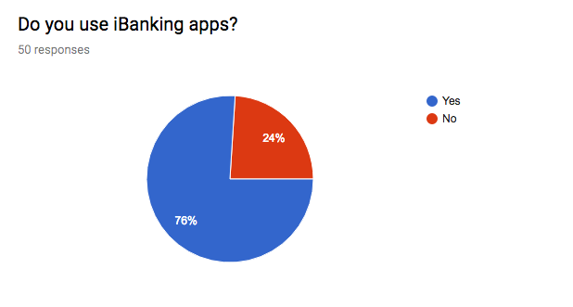
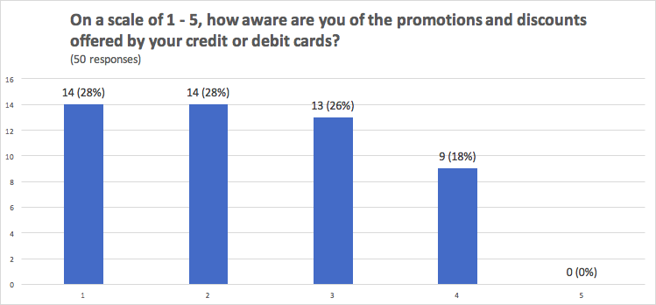
Primary data: Survey
76% of sample population use iBanking apps
Awareness of card promotions on average: 2.34

Slide 7
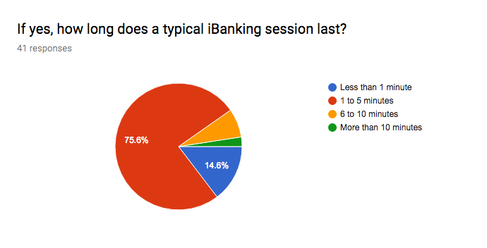
Primary data: Survey
Majority of iBanking users spend: 1 to 5 minutes

Slide 8

Persona
Andy Tan
Needs:
Wants to be efficient with money:
Preparing for marriage, his first house and car
Behaviour:
Heavily reliant on his phone for discount apps
Enjoys leisurely activities during the weekends
Pain Points:
Irritated with constant notifications on banking promotions
Feels like it’s a waste time looking through promotions
Bio
Fresh graduate. Currently working in a professional job. Facing new responsibilities, beginning to understand the value of money.

Slide 9

Qualitative research: Effective Engagement
AR
AR
Game mechanisms can enrich user interactions while still serving a business purpose.
(Zichermann & Cunningham, 2011)
Induce stickiness and encourages mindshare with users.
Above: Our app logo, ARound

Slide 10


3 Key Elements
Stacking
The Marketplace
The Canopy

Slide 11




Element #1: Stacking
Timed Deals.
Forms as an incentive to head out
Based on user’s tier of credit cards
% vs cents (DelVecchio, Krishnan and Smith 2007)
Stacked to a certain percentage based on the underlying agreement with the merchant.

Slide 12
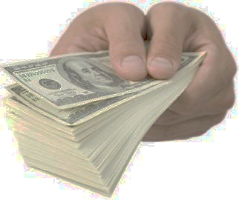
Element #2: The Marketplace
Failure of Pokemon Go: lack social aspect to the game
27m downloads fell to 700k in 2 months.
Effective circulation of vouchers.
Actively trade/auction and negotiate for vouchers.
Deloitte research: higher propensity to spend online
Increased probability of users making an actual purchase.

Slide 13
Element #3: The Canopy
Consolidated view of existing card details.
Advertise cards that resonates the best with user’s profile.
(Future Iteration) Funds Transfer via facial recognition for F&B purchases.
Top 20 rare voucher findings.
Spreads awareness about such deals (induce excitement)
Security is paramount
Secured interface which uses 3-way authentication.

Slide 14
Business Plan: Milestone
T+2 Actual Release of polished product:
- Ongoing process of troubleshooting and polishing of app
T+4
Future Improvements & Iterations 2: - “Trending” tab for featured credit cards
- Leaderboard for most frequent users: additional rebates and points
T+0
Pitching of idea:
- Marketing
- Focus group survey and feedback
T+1 Beta Release:
- Contact merchants
- Integrate to system
- Data collection and analysis - Optimization and iterations from feedbacks
T+3
Future Improvements & Iterations 1: - Integrate new features with already existing iBanking features
- Voice activation
Notes:
Thanks Riwu. SO now that you guys have got a taste of how our app works, let me introduce to you

Slide 15
Why You Should Buy Our Idea
Rapid expansion of client base
Increase in opening of accounts
Increase in spending among consumers
Increase in revenue from fees (interchange and late fees)

Slide 16

Why You Should Buy Our Idea
2. Captures the entire market
Enables cross-selling of products & services in a seamless manner
1-stop platform for all banking information and services (E.g. Google)

Slide 17
X Factor
Engaging
Enriching
Economic
Notes:
Engaging: Engaging customers through gamification and incorporating elements of fun ➔ branding (getting banks more involved with customers’ everyday lives)
Enriching: Customer’s experience ➔ catering to the evolving needs of consumers in a digitized world ➔ convenience Economic: Cutting costs and increasing margins and profits for banks ➔ + consumers also gain in the process whereby they can trade points and vouchers with each other which brings efficient economic exchange between people to a whole new level.

Slide 18
THANK YOU
Notes:
(Concluding statement..) We believe that our product would not just be a value add to individual banks, but a technological revolution to the whole of the banking industry.
With that, we will end our presentation, and hope you guys are convinced that our product is THE revolutionary product.

